Slide 1




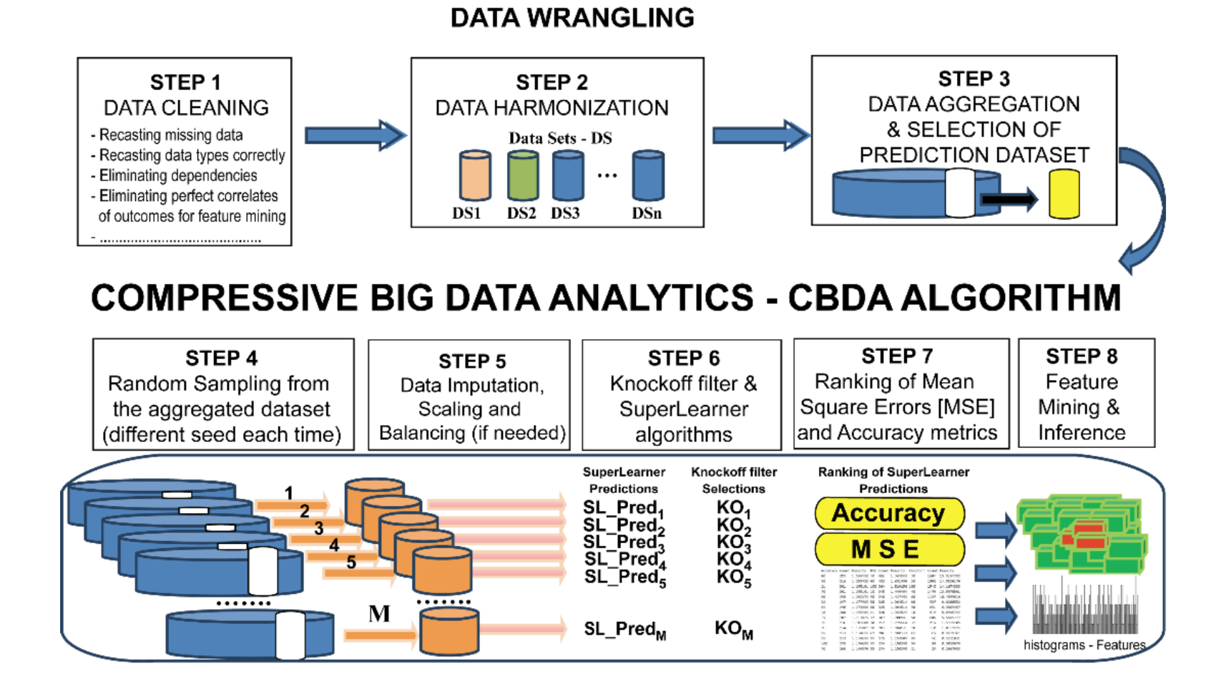
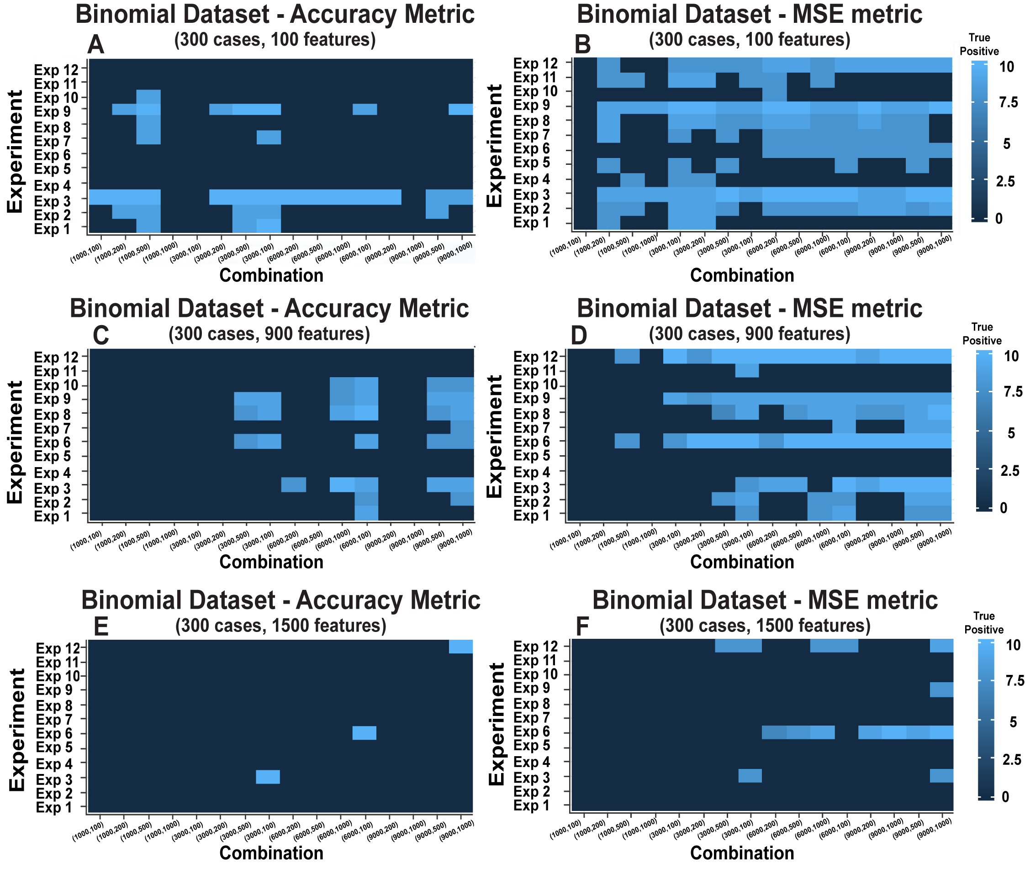
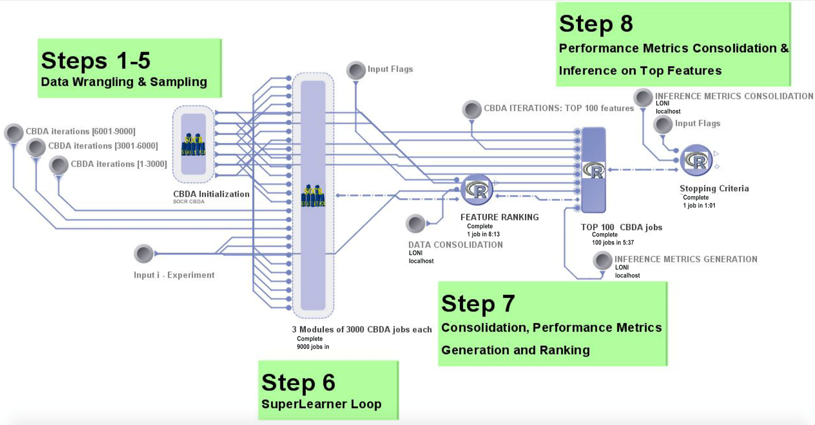
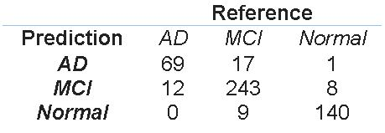
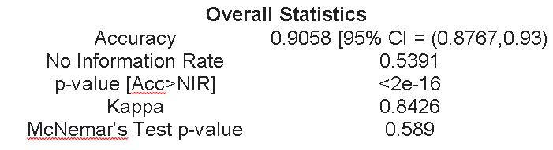
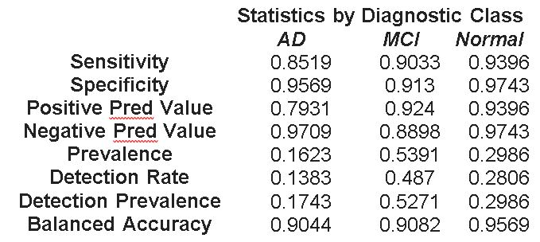
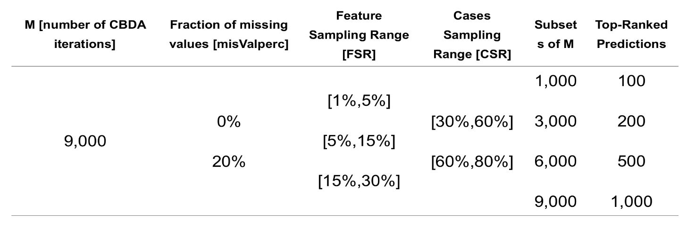
Compressive Big Data Analytics - CBDA
Applications to Biomedical and Health Studies
Simeone Marino, Jiachen Xu, Yi Zhao, Nina Zhou, Yiwang Zhou,
Yehu Chen, Yingsi Jian, Qiucheng Wu, Yichen Yang, and Ivo D. Dinov
Introduction
Framework & High Performance Computing
Biomed & Health Applications
Background
Big Healthcare Data Science deals with enormous amounts of complex, incongruent, and dynamic data (Big Data) from multiple sources and aims to develop algorithms, methods, tools, and services capable of ingesting such datasets and generating semi-automated decision support systems.
Major challenges in Big Healthcare Data analytics include:
Choice of reliable predictive model(s) to apply to the data
Specification and implementation of optimal algorithm(s)
Feasibility, scalability and convergence of the protocol on large datasets
Access to appropriate computational resources
We propose Compressive Big Data analytics (CBDA) to tackle most of these challenges. CBDA allows us to identify critical data features associated with specific traits, track multivariate relations and predict high-order trends in data. We also design a HPC pipeline to evaluate CBDA performance with precipitated time complexity in complex simulated and observed biomedical data. The CBDA flowchart is shown in Figure 1.
Models
CBDA is based on an ensemble predictor called SuperLearner (SL) that combines many different pre-defined algorithms into a single predictive model. The SuperLearner function takes the training set pair and returns the predicted values based on the validation data and the weights of each algorithm in final ensemble for further inference, and therefore greatly simplifies the choice of the predictive model(s) to apply to the data.
Datasets
We validate the CBDA technique on three independent datasets. The first two, namely the Null and Binomial datasets, are synthetically generated as cases and features for the purpose of testing the protocol and assessing the CBDA performance. For all the Binomial datasets, only 10 features are used to generate the outcome variable. The third case-study represents a real biomedical dataset on Alzheimer’s disease using clinical and neuroimaging measures.
Software/Tools
The CBDA protocol is developed in the open source R environment (https://www.r-project.org/Licenses/).
The CBDA R package R1.0.0 is now available on CRAN (https://CRAN.R-project.org/package=CBDA ).
Production runs and validation of the CBDA protocol uses the open source workflow application LONI pipeline (http://pipeline.loni.usc.edu/).
CBDA Framework & HPC(LONI Pipeline)
Results
Figure 4: Heatmaps of CDBA protocol performance for the binomial datasets across 12 different experiments summarized in Table 1
Figure 3: Feature mining results of the CBDA protocol applied to the Null and Binomial Datasets. The spikes on panels B, D and F represents the true features
MAIN RESULT: Even with low undersampling rates, the CBDA protocol can identify most of the true features.
Figure 1: CBDA Framework
Figure 1 describes the main steps of the CBDA protocol.
LONI Pipeline in Figure 2 enables us to utilize the algorithm on a way bigger data set with the following advantages:
High throughput
Scalable
Efficient
Fast Computational
MAIN RESULTS on the Alzheimer Dataset
- The MSE metric is more effective in increasing the CBDA performance.
- With an increased number of features, the CBDA has less optimal combinations that reach our minimal target level of true positives (i.e., 7 out of 10)
- Across the 3 binomial datasets, certain experiments (i.e., FSR and CSR pairs) are performing consistently better, e.g., Experiments 3, 6, 9 and 12.
FEATURE MINING RESULTS
CBDA protocol ranked the top 1,000 predictions out of the 9,000 learning samples (i.e., Combination 16 in Figure 4). The validation step (see Figure 2 LONI pipeline) then returned the following top 10 predictive features: CD Global, weight [kg], sex, age, Right cingulate gyrus, FAQ Total, Left gyrus rectus, Right putamen, cerebellum and Left middle orbitofrontal gyrus.
The accuracy was ~90.5%, with 95% confidence interval of [87.67%, 93%] (see Table 2).
Figure 2: LONI Pipeline workflow
Datasets for Validation
Null Datasets
The outcome with is completely independent from the set of features X. Each column of with
Binomial Datasets
We select 10 features from X to build a linear additive model with
and Then outcome Y is generated by with
*n and p are number of cases and features respectively.
ADNI Case-Study
This dataset consists of three cohorts of patients (2,500 cases) with three diagnoses : EO-AD (Early Onset Alzheimer Disease, N1=406), Normal (N2=747) and EO-MCI (Early Onset Mild Cognitive Impairment, N3=1,347).
Table 2: Confusion Matrix and Statistics
Conclusions and Discussion
Experimental Design
The CBDA method takes a divide-and-conquer approach utilizing ideas from Compressive Sensing (CS) and Signal Processing (SP). Different from ordinary learning and statistical model, we combine subsampling and boostrapping with an ensemble algorithm strategy (i.e. SuperLearner) to exploit as many machine learning, classification, statistical modeling tools and ensure the best predictive model generation. We tested our first generation CBDA protocol on both synthetically generated and real datasets. Current results provide evidence of the effectiveness of CBDA to deal with complex and heterogeneous real data application.
Further studies will examine the theoretical CBDA properties and the performance of the CBDA technique on larger biomedical datasets. Meanwhile, we are exploring the CBDA mathematical properties, e.g. conditions that guarantee CBDA convergence.
Publications
Simeone Marino, Jiachen Xu, Yi Zhao, Nina Zhou, Yiwang Zhou and Ivo D. Dinov. Controlled Feature Selection and Compressive Big Data Analytics: Applications to Biomedical and Health Studies. PLOS ONE Bioinformatics (accepted for publication) [info: simeonem@umich.edu, dinov@umich.edu]
Controlled settings in Table 1 include:
M: Number of the instances/jobs
misValperc: % of missing values introduced
FSR: Ranges to select a fraction of features
CSR: Ranges to select a fraction of cases
Support
SOCR is supported by: University of Michigan School of Nursing, NSF grants DUE 1416953, 0716055 and 1023115, and NIH grants P20 NR015331, U54 EB020406, P50 NS091856, P30 DK089503
Table 1: Experimental Design
Subset of M: Number of subsets to perform CBDA-SL feature mining
Top-Ranked Predictions: Number of top predicted subsets to perform feature mining

